Slide 1
Object Oriented Programming In Java
Saurabh Pandey
Associate Professor
Sitare University

Slide 2
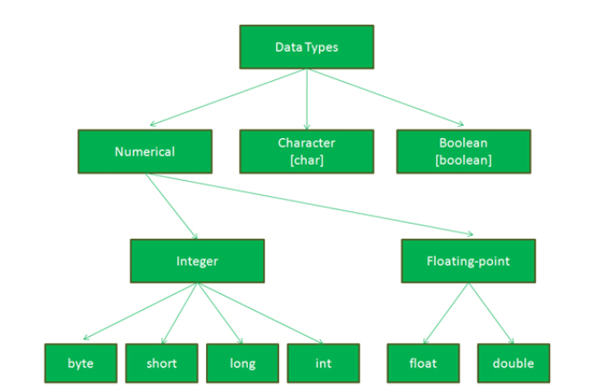
Types of Variables : Primitive
Primitive
Reference or object variable

Slide 3
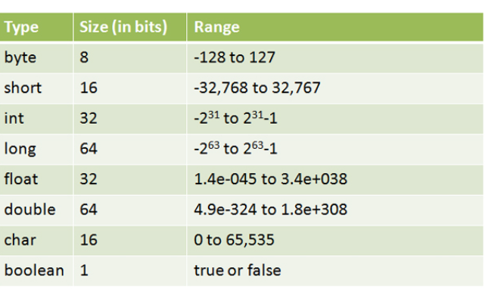
Types of Variables : Primitive
Primitive:
*Java thinks anything with a floating point is a double, unless you use ‘f’.
*Floats can represent decimal values up to 7 digits of precision, and double can represent decimal values up to 16 digits of precision.

Slide 4
Types of Variables : Primitive
Variable Names:
you need a name and a type for your variables.
It must start with a letter, underscore (_), or dollar sign ($). You can’t start a name with a number.
After the first character, you can use numbers as well. Just don’t start it with a number.
It can be anything you like, subject to those two rules, just so long as it isn’t one of Java’s reserve words.

Slide 5
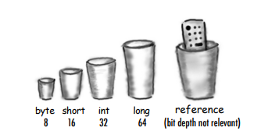
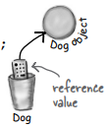

Types of Variables : Reference or Object variable
Object Variable:
There is actually no such thing as an object variable.
There’s only an object reference variable.
An object reference variable holds bits that represent a way to access an object.
It doesn’t hold the object itself, but it holds something like a pointer. Or an address. Except, in Java we don’t really know what is inside a reference variable. We do know that whatever it is, it represents one and only one object. And the JVM knows how to use the reference to get to the object. Object is always created in Garbage collectible heap.

Slide 6
Life and death on garbage collectible heap
Book b = new Book();
Book c = new Book();
Book d = c;
c = b;
D = null;
Show pictorial presentation.

Slide 7
Encapsulation
Encapsulation is the process that binds together the data and code into a single unit and keeps both from being safe from outside interference and misuse. In this process, the data is hidden from other classes and can be accessed only through the current class’s methods. Hence, it is also known as data hiding.
To achieve encapsulation in java, follow certain steps as proposed below:
Declare the variables as private
Declare the setters and getters to set and get the variable values
There are few advantages of encapsulation in java as follows:
Control Over Data: We can write the logic in the setter method to not store the negative values for an Integer. So, by this way we can control the data.
Data Hiding: The data members are private so other class can’t access the data members.
Notes:
Basic level of security

Slide 8
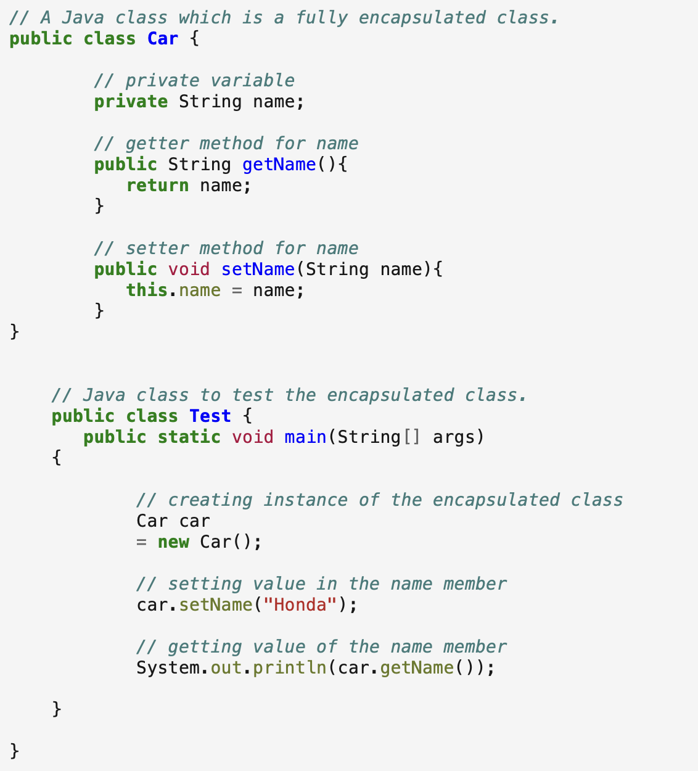
Example:

Slide 9
Variable default values
Instance variables always get a default value. If you don’t explicitly assign a value to an instance variable, or you don’t call a setter method, the instance variable still has a value!
integers 0
floating points 0.0
boolean false
references null
Local variables do NOT get a default value! The compiler complains if you try to use a local variable before the variable is initialized.

